Slide 1



Crop & Fertilizer Recommendation System using ML
-- Grishma Gedela

Slide 2

Learning Objectives
Understand how machine learning is used for crop recommendation.
Learn data preprocessing techniques for agricultural datasets.
Implement and evaluate a Decision Tree Classifier for prediction.
Develop an AI-powered crop and fertilizer recommendations.
GOAL
Source :
www.freepik.com/

Slide 3
Tools and Technology used
Programming Language: Python
Libraries: NumPy, Pandas, Scikit-learn, Matplotlib
Machine Learning Model: Decision Tree Classifier
Development Environment: Jupyter Notebook
Dataset: Crop Dataset

Slide 4
Methodology
1️⃣ Dataset Collection – We used a pre-existing crop dataset containing soil properties and climate conditions. 2️⃣ Data Preprocessing – Encoding categorical variables, handling missing values, and feature scaling. 3️⃣ Splitting Data – Divided into training and testing sets. 4️⃣ Model Training – Applied Decision Tree Classifier for prediction. 5️⃣ Prediction & Evaluation – Assessed accuracy and recommended the best crop based on environmental factors.

Slide 5
Problem Statement:
“ Farmers struggle to determine the best crop and fertilizer for their soil conditions, leading to lower yields and financial losses.”
🔹 Soil conditions (NPK levels, pH, rainfall) vary significantly. 🔹 A wrong crop choice leads to inefficient farming and loss of resources. 🔹 Manual decision-making lacks precision.

Slide 6
Solution:
Our AI-powered model takes Nitrogen (N), Phosphorus (P), Potassium (K), Temperature, Humidity, pH, and Rainfall as inputs and predicts the best crop for cultivation.
Example Input: ✅ N = 90, P = 42, K = 43 ✅ Temperature = 20°C, Humidity = 82% ✅ pH = 6.1, Rainfall = 202 mm
Predicted Output: ✔ Best Crop Recommendation → Rice 🌾

Slide 7
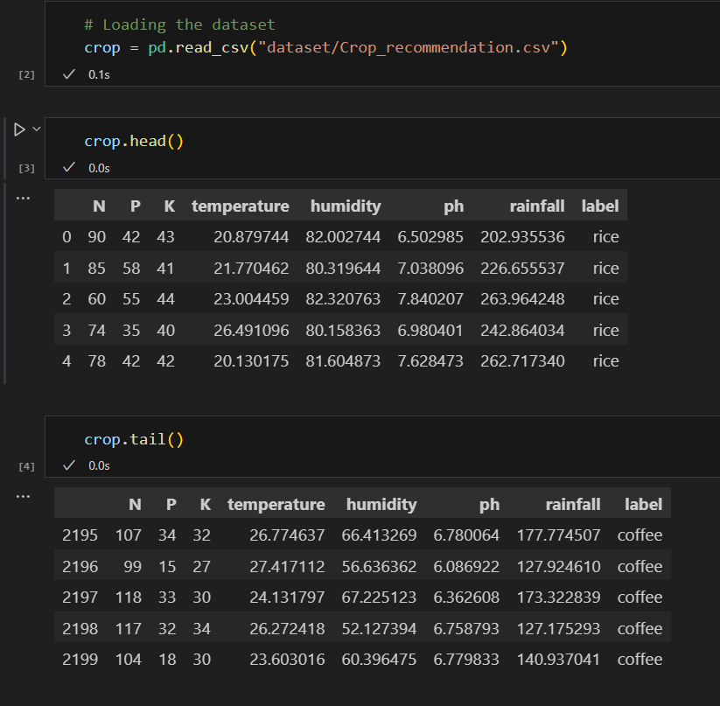
Screenshot of Output:
DataSet Overview ( Before Preprocessing )
The dataset contains agricultural soil and climate parameters, including:
✅ Nitrogen (N), Phosphorus (P), Potassium (K) ✅ Temperature, Humidity, pH, Rainfall ✅ Target variable: Recommended Crop
The dataset is loaded and displayed before preprocessing.

Slide 8
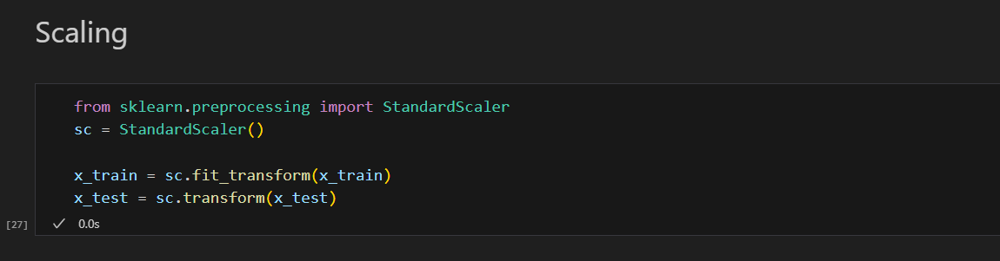
Data Preprocessing ( Feature Scaling & Encoding )
Feature Scaling:
✅ MinMaxScaler ensures all features have values between 0 and 1. ✅ Helps machine learning models learn better and faster.
✅ Standardizes features to have zero mean and unit variance.
✅ Prevents features with large values from dominating the model.

Slide 9
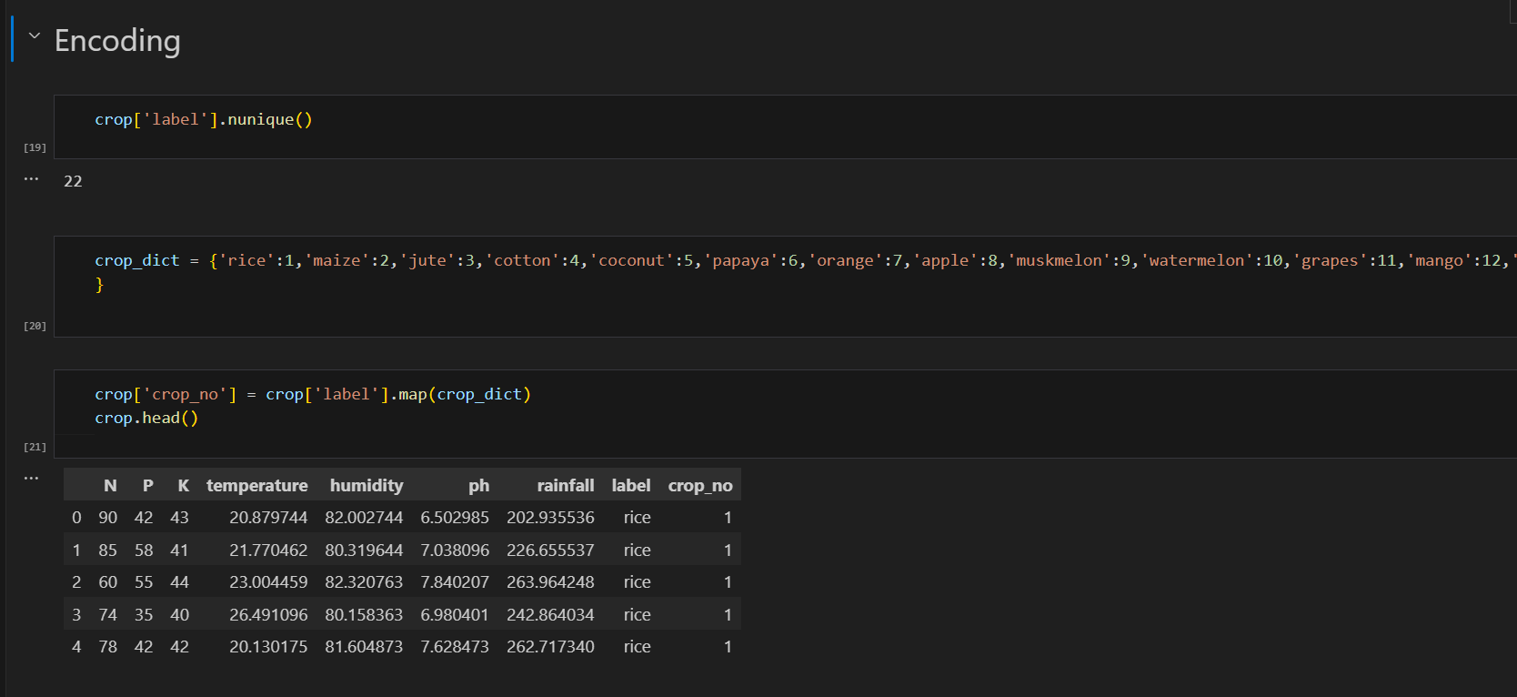
Data Preprocessing ( Feature Scaling & Encoding )
Label Encoding: Converts crop names into numerical values.

Slide 10
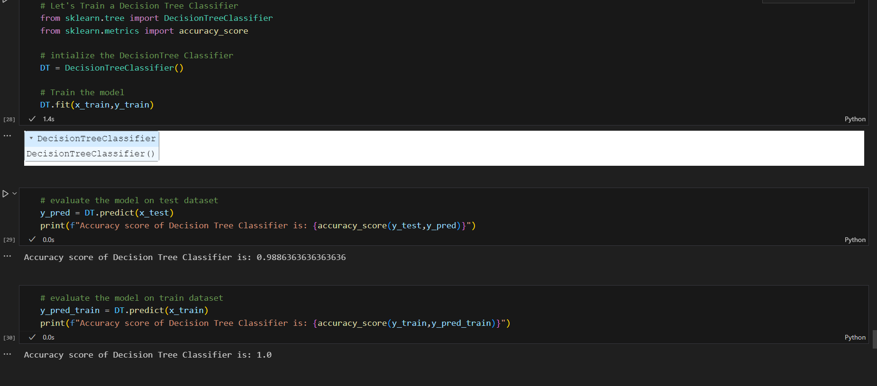
Model Training Output ( Decision Tree Classifier Accuracy )
- Decision Tree Classifier trained on agricultural data. - Model is tested on unseen data for evaluation. - Higher accuracy means better crop prediction performance.

Slide 11
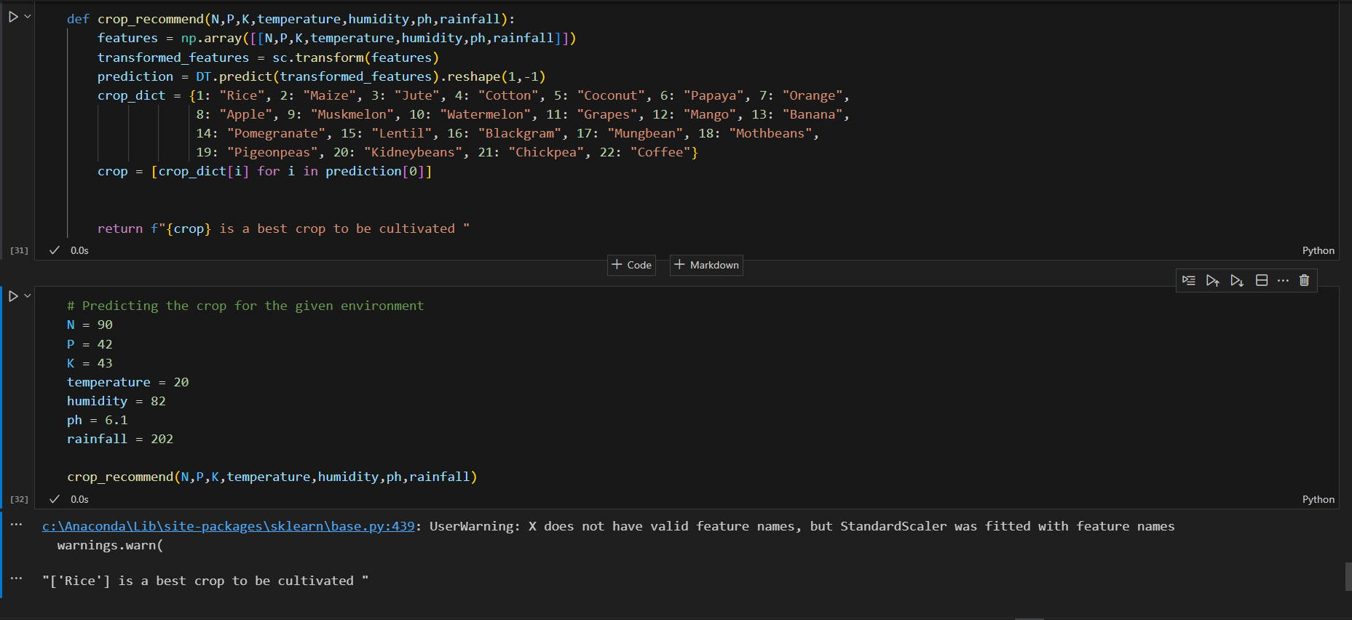
Final Prediction Output ( Crop Recommendation )
Input Parameters: Soil nutrients, temperature, humidity, pH, rainfall.
Model Output: Suggests the best crop for farming.
---- Example:
✅ Input: N=90, P=42, K=43, Temp=20°C, Humidity=82%, pH=6.1, Rainfall=202mm ✅ Output: Recommended Crop → Rice 🌾

Slide 12
Conclusion:
✅ The Crop and Fertilizer Recommendation System helps farmers make data-driven decisions. ✅ It analyzes key factors like soil nutrients, weather conditions, and pH levels. ✅ The Decision Tree model provides accurate crop recommendations. ✅ This system enhances agricultural productivity and sustainability.

